Slide 1
OpenFlow for Wireless Mesh Networks
Dely, P. , Kassler, A. ; Bayer, N., Karlstad Univ., Karlstad, Sweden , Computer Communications and Networks (ICCCN), 2011 Proceedings of 20th International Conference on

Slide 2
Outline
Introduction
Routing protocols in Wireless Mash Networks.
Motivation
System architecture
Evaluation
Pure test
Seamless handover
Conclusion
Reference

Slide 3
Routing protocols in Wireless Mash Networks
Ad hoc On-Demand Distance Vector (AODV)
Optimized Link State Routing Protocol (OLSR)
Nodes advertise information only about links with neighbors.

Slide 4
Motivation
There are many traditional routing protocols in WMS, but they are not flexible enough for some requirement such as load-balancing.

Slide 5
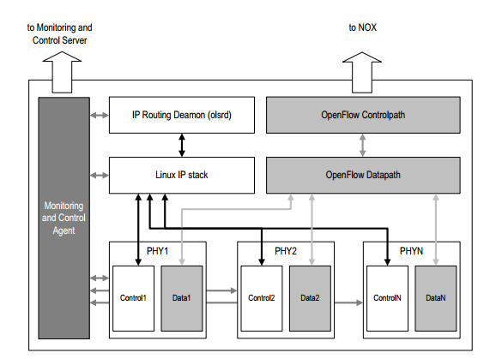
System architecture
Architecture of an OpenFlow Mesh Node

Slide 6
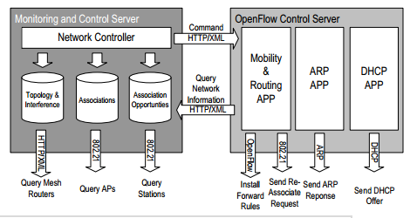
System architecture
Architecture of the core network

Slide 7
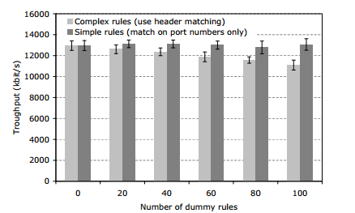
Evaluation-Forwarding performance

Slide 8
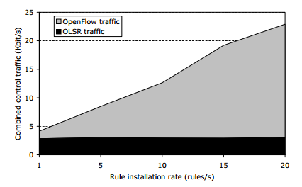
Total control traffic caused by OLSR and OpenFlow

Slide 9
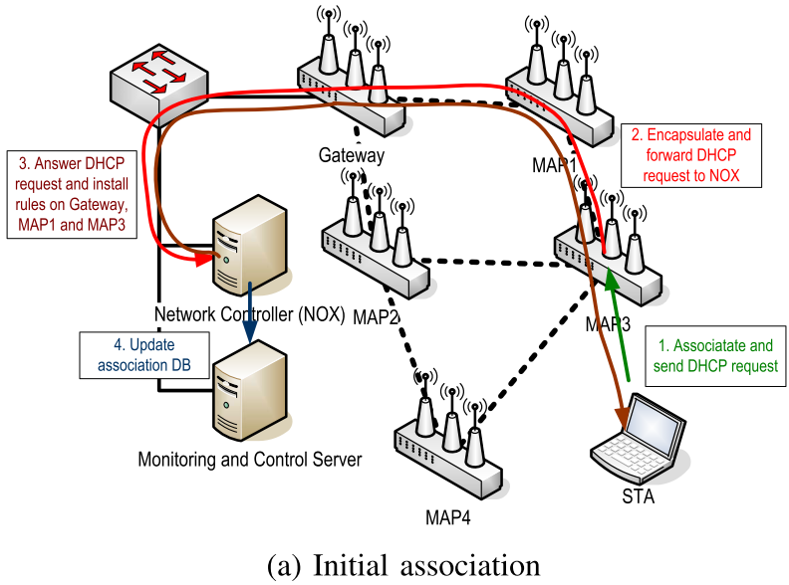
Evaluation -seamless handover

Slide 10
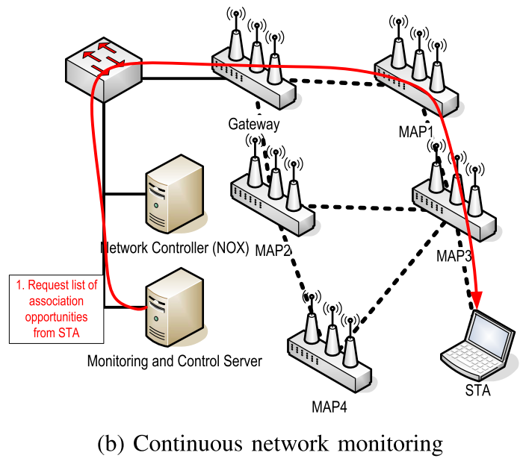

Slide 11
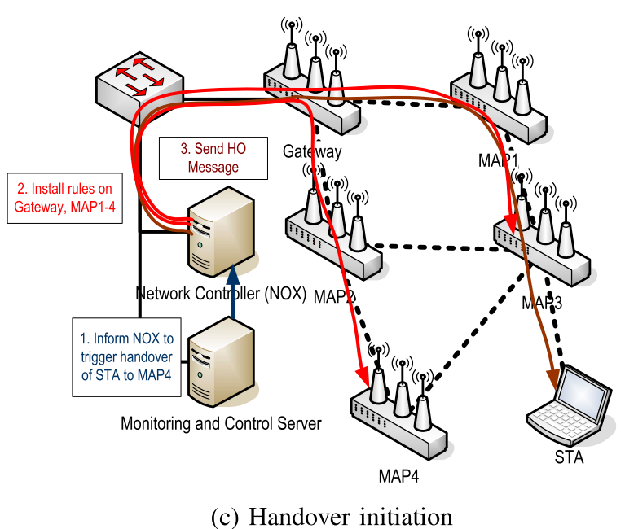

Slide 12
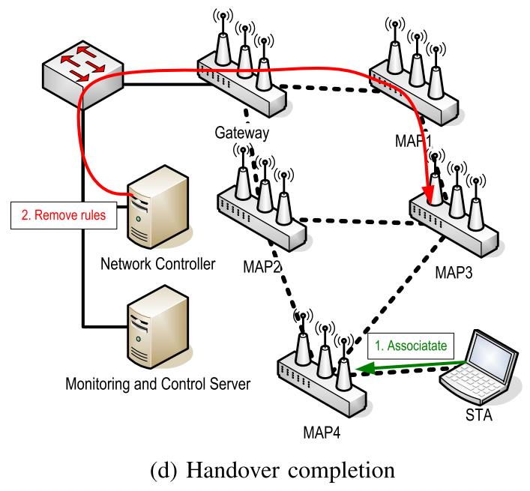

Slide 13
TCP throughput from the core-network to the station during two handovers (after 15 and 30 sec.)

Slide 14
Conclusion
The architecture combines the benefits of OpenFlow (flexible packet forwarding) and WMNs (self-configuration and error-resilience)
Handover with OpenFlow can provide a more efficient way for access point choosing.

Slide 15
Reference
OLSR, [http://en.wikipedia.org/wiki/Optimized_Link_State_Routing_Protocol]
OLSR,[http://www.soi.wide.ad.jp/class/20060035/slides/04/index_43.html]

